Slide 1
CSCI E-33a Section 0
HTML and CSS

Slide 2
Welcome
Notes:
Add personalized welcome?

Slide 3
Logistics
Notes:
Add stuff like structure of course, prerequisites, expectations

Slide 4
Course Logistics
Make sure to sign up for Ed!
Check out the syllabus at cs50.harvard.edu/summer/web/2020/syllabus/ for:
Lecture Release Dates
Project Release/Due Dates
Collaboration Policy
Grading Policy
Watch Lectures 0, 1, and 2 this week
Project 0 due at 11:59pm on June 28

Slide 5
Zoom Logistics
When you join the meeting, your microphone will automatically be muted, but feel free to unmute it when you wish to speak, then mute it again
I’ll pause for questions periodically, but feel free to use the “Raise Hand” feature if you have a question and I’m still talking!
Video is encouraged, but of course not required.

Slide 6
Class Preparation
Sections prep:
● Watch the lecture ahead of the section
● Review the project requirements early
Office hours prep:
● List your questions ahead of time to streamline the discussion and assure all
questions are answered
● Write your questions down the moment they come to mind and address later

Slide 7
Grading/Projects
5 projects with equal weight + 1 final project
Correctness, Design, and Style
Tips for Projects:
Read all requirements!
Start early!
Use online searches, Ed, office hours, and peers
Correctness > Design > Style
Submit a Google Form with each project
Create a new Git Repository for each project and commit regularly! (You’ll learn how to do this in the next lecture)
Make sure to submit all files associated with that project

Slide 8
Troubleshooting Tools
Chrome Inspector
Online Q&A Forums (Stack Overflow, GitHub, etc)
Ed (Your questions and other questions)
Office Hours
Peers

Slide 9
Using the Command Line / Terminal
cd <directory name>
stands for “change directory” and moves you into the directory passed as an argument
current directory/parent directory:
“.” can be used in place of the current directory
“..” can be used in place of the parent directory
mkdir <directory name>
Used to create a new Directory
rm <file name>
permanently removes file
to remove an entire directory: “rm -r <directory name>” (the -r stands for ‘recursive’)

Slide 10
Using the Command Line / Terminal
ls
Lists all files and directories in the current folder
“ls -a” lists all files and directories, including hidden files. (These can include files that contain formatting details, as well as a git file, which we normally do not need to worry about)
mv <old file path> <new file path>
Used to move or rename files
If moving to another directory, make sure to put at “/” at the end of the new file path
CTRL-C
Aborts the current command

Slide 11
Using the Command Line / Terminal
touch <file name>
creates a new file in your current directory
TAB
This isn’t really a command, but if you have a large file/directory name, beginning to type the name and then pressing TAB will autocomplete.
clear
clears up what is currently displayed to reduce clutter
UP and DOWN arrows
Use these to toggle through past commands
Edit files using nano or vim

Slide 12
Lecture Review
Notes:
Add stuff like structure of course, prerequisites, expectations

Slide 13
HTML
Hypertext Markup Language
Notes:
Add stuff like structure of course, prerequisites, expectations

Slide 14

HTML
Defines the structure of a page
Tags are used to outline content
Attributes are used to describe tags
Tags are nested within other tags

Slide 15
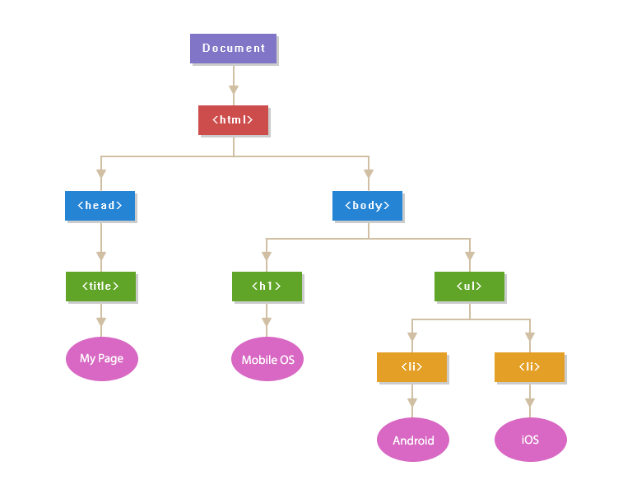
Document Object Model (DOM)

Slide 16

Structure Overview
<!DOCTYPE html>
<html lang=“en”>
<head>
<title>Page Title</title>
</head>
<body>
Page Content Here
</body>
</html>

Slide 17
Commonly Used Tags
Headings (h1 -> h6)
Links (a)
Paragraphs (p)
Images (img)
Ordered/Unordered Lists and List items (ol, ul, li)
Tables (table)
Forms (form)
User Input (input)
Find out about more tags:
Search “How to include _______ in an HTML page”
Check out sites like W3 Schools or Mozilla

Slide 18
Exercise
Make a web page with at least 4 different tags within the body.
For our in-class example (section.html), we’ll include:
A heading
An unordered list
A paragraph
A table

Slide 19
CSS
Cascading Style Sheets
Notes:
Add stuff like structure of course, prerequisites, expectations

Slide 20

CSS
Used to add style to our web pages
Can be added by:
Adding style attributes to HTML tags (worst)
Writing within a style tag in the page head (better)
Writing in a separate .css file and linking to that file in the page head (best)

Slide 21
CSS Selectors and Specificity
Selector | How to Reference | Priority Given
In-line CSS | Within tag (eg: <p style=”...”>) | First
id | Hashtag (eg: #some_id {...}) | Second
class | Period (eg: .some_class {...}) | Third
Element Type | Element Name (eg: h1 {...}) | Last

Slide 22
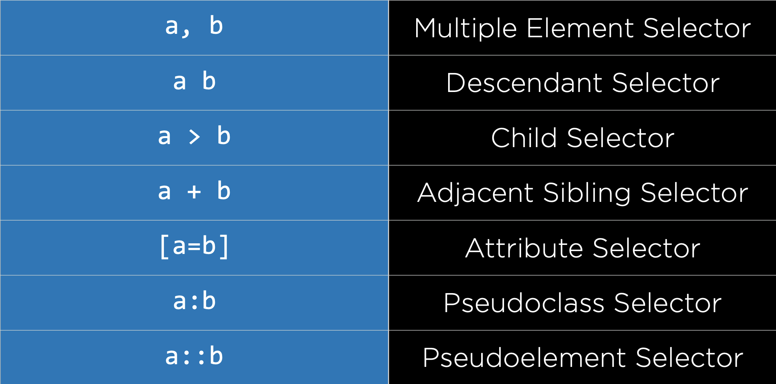

Slide 23
Common Attributes
text-align (center, left, right)
color
font-size
background-color
margin/border/padding
height, width
Many More!

Slide 24
Exercise
Adding Style to our HTML page:
Change the color of the heading
Center the heading
Challenge: highlight rows on mouse hover (We can use the CSS pseudo class :hover)

Slide 25

Bootstrap
Open-Source Software useful for styling websites
Get Started here
Check out components here
Exercise: Let’s work on making our page look even nicer with Bootstrap!

Slide 26
Responsive Design
Notes:
Add stuff like structure of course, prerequisites, expectations

Slide 27
Media Queries
Rules for styling only applied when certain conditions are met.
Common Query for applying styling only on a small mobile screen: @media only screen and (max-width: 600px)
Exercise: Here we’ll use the display tag to show hidden content only on small screens.

Slide 28
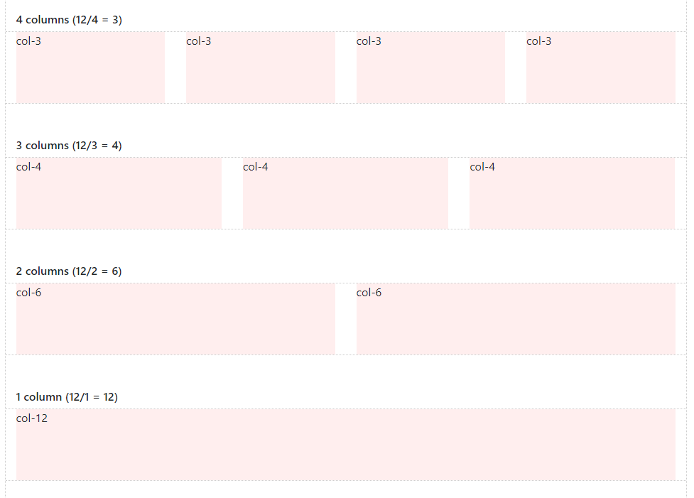
Other Responsive Methods
Flex Boxes
Grids
Bootstrap Columns
Demonstration: Let’s take a look at how we can implement these!

Slide 29
Sass
Syntactically Awesome Style Sheets
Notes:
Add stuff like structure of course, prerequisites, expectations

Slide 30
Sass
Allows for:
Declaration of Variables
Nesting of CSS Selectors
Creating Styling Classes that can be Extended
Must be compiled into a CSS file
First, make sure to download Sass
Compile with command sass file.scss:file.css
or track changes with sass --watch file.scss:file.css
Demonstration
Create a Sass file to replace our current CSS file
Use variables to describe colors or width/heights
Use inheritance to make each set of divs a different color

Slide 31
Questions?
Notes:
Add stuff like structure of course, prerequisites, expectations

Slide 32
Project Preview
Notes:
Add stuff like structure of course, prerequisites, expectations

Slide 33

Re-Making Google
You will be creating a functional Google Search page.
It will be useful to look up and get an idea of:
HTML Form Action Attributes
What happens when you make a google search. Try the Chrome Inspector and the URL bar for this.

Slide 34
CSCI E-33a Section 0
HTML and CSS

